Slide 1

Clean Bite, Inc. Develops, Prototypes, and Patents Oral Hygiene Products for People and Companion Pets
John H. Gallagher, Jr.
President and CEO
jgallagher@CleanBiteTM.com
Phone | 610.520.9941
Clean Bite™
Clean Bite, Inc.
Haverford, PA 19041
U.S.A.
www.CleanBiteTM.com

Slide 2
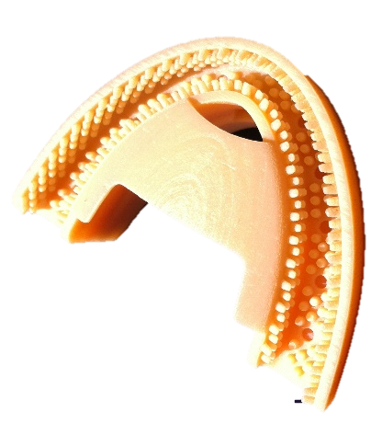
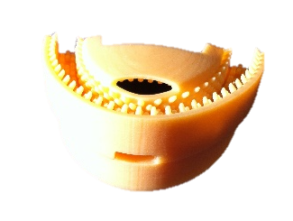
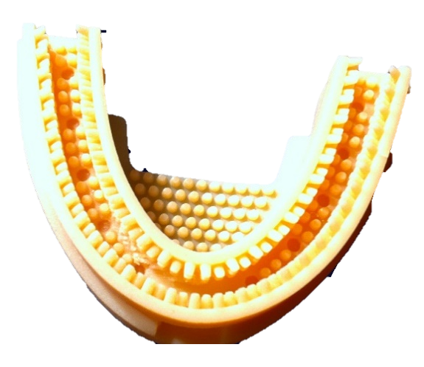
Clean Bite™ I
Clean Bite™ I is a PATENTED single-use toothbrush made from gelatin foodstuff.
When chewed, compartments containing LivFresh Dental Gel toothpaste burst on compression, distributing throughout the mouth to brush the teeth, gingival margin, and tongue
Utility period nearly the same as a toothbrush at 90 seconds, followed by disintegration and consumption by the user
NO WATER required for use or consumption
Clean Bite™ I is designed to provide oral hygiene in all situations where traditional means are unavailable or inappropriate.
https://cleanbitetm.com/cleanbite-i/

Slide 3
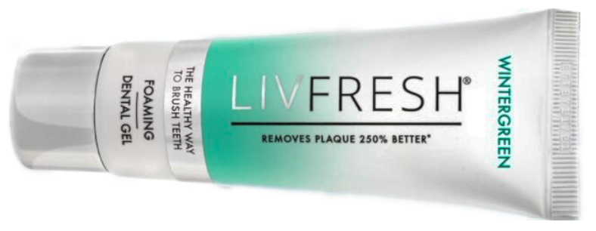


LivFresh Dental Gel Toothpaste
Dentifrice Plaque Control
One of the most substantial breakthroughs in the dental industry since the introduction of fluoride in 1914
Clinically proven to remove plaque 250% BETTER than a market leader
All ingredients are edible and contain ZERO abrasives, antimicrobials, parabens, gluten, sugar, triclosan, & SLS
LivFresh maintains a European Union CE mark as a certified toothpaste for the prevention & treatment of periodontitis & gingivitis as an adjunct to professional care, 2021
Approved in the EU as the first over-the-counter toothpaste for consumers suffering from periodontitis or gingivitis.
These oral diseases affect up to 90% of Adults.

Slide 4
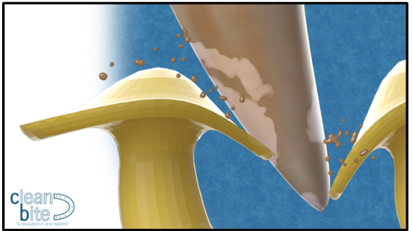
Clean Bite™ II
In 2019, Clean Bite, LLC filed a patent application for an oral appliance, Clean Bite™ II, targeting the companion pet market
Designed to brush the teeth of dogs and cats with the same level of efficacy as achieved by owners using a toothbrush.
Clean Bite™ II features bristles made in the shape of a dome that deflects when it is masticated. There is a brim around the circumference edge that rubs the surface of the tooth, agitating the LivFresh Dentrifice, while gently removing plaque.
Protect your pet from other chewable pet dental products by preventing
potential bruising of the gums from over-brushing or sharp shards!
U.S. Patent No. 11,730,144, EU Patent No. 3923857, India Patent No. 438316
Subsequent European Patents by Country: Austria, Belgium, Bulgaria, Switzerland, Czech Republic, Germany, Denmark, Estonia, Spain, Finland, France, United Kingdom, Ireland, Italy, Liechtenstein, Lithuania, Luxembourg, Latvia, Malta, Netherlands, Norway, Poland, Portugal, Sweden, and Slovenia

Slide 5
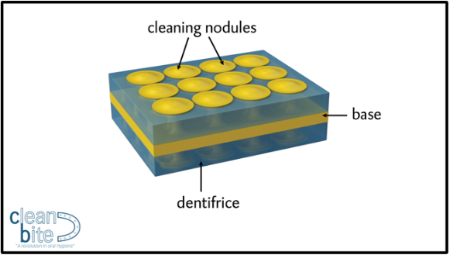
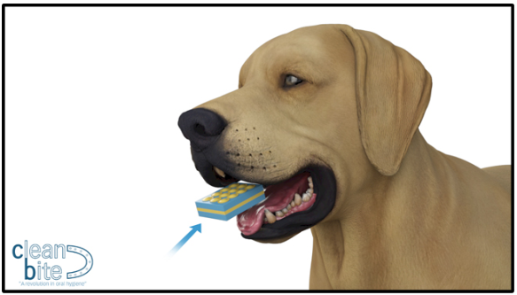
“Clean Bite™ II” and “Clean Bite™ II Interact” FOR COMPANION PETS
Structure (yellow)
A foodstuff core pad providing a monolithic connection to the upper and lower bristles, which may vary in patterns and shapes depending on the specific application.
Dentrifice (Blue)
LivFresh Dental Gel, by Livionex, Inc., fills the structural core throughout the bristle pattern to immerse the exposed surfaces of the pet’s teeth while masticating
Sizing
Appropriately bite-size treat for companion pet
Completely soluble and ingestible with no additional water required!

Slide 6
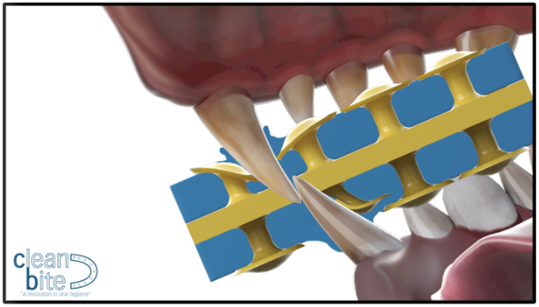
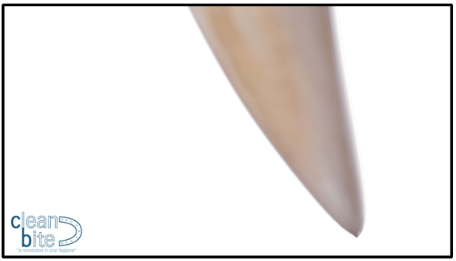
“Clean Bite™ II” and “Clean Bite™ II Interact”
As the pet bites down on Clean Bite™ II, both the cap and supporting column deflect the mushroom-shaped bristles. As the teeth deflect the bristles and penetrate the monolithic pad, the brim on the circumference of the cap, which is inverted, gently brushes LivFresh Dental Gel across the surface of the teeth. This motion activates LivFresh, to break down plaque on the tooth surface.
Most dogs (80%) and cats (70%) will develop periodontal disease by their third year.
Keeping your pet’s teeth clean will contribute to good oral hygiene and overall better health for your best friend.
No abrasive aggregate or detergents
No fractured shards to scrape the tooth’s surface

Slide 7

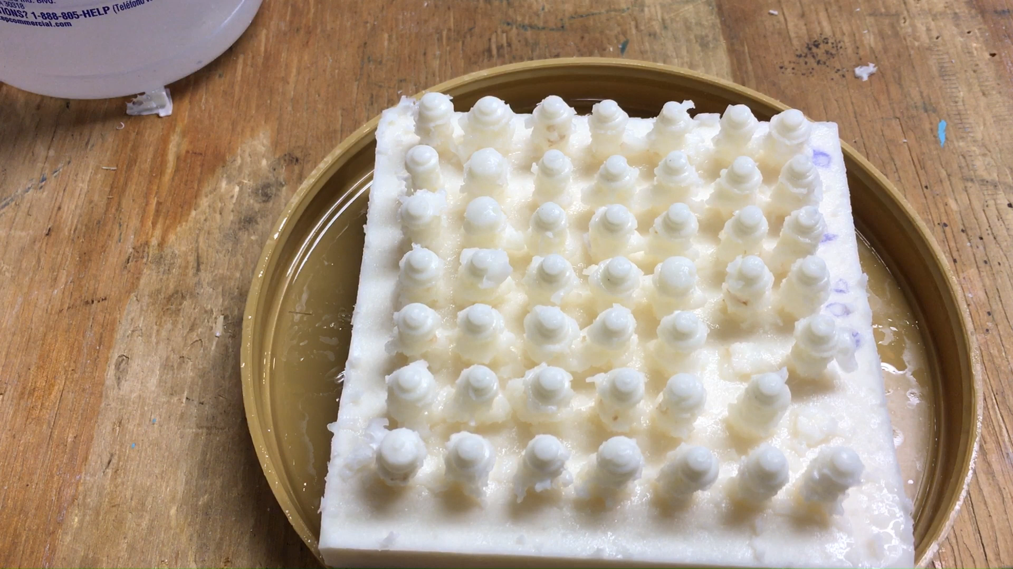
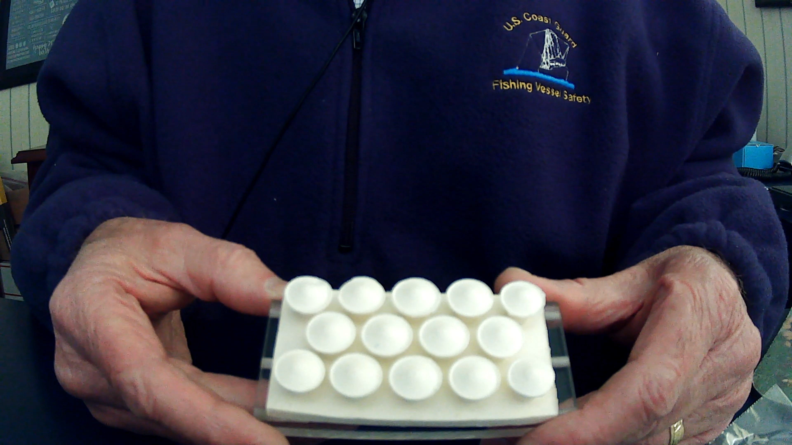
Stages Of Development of Endothermic Injection Molding
Schematic Early Mold Failure Molding & Demolding
CLICK VIDEOS TO PLAY
These development stages identified the critical path to designing Clean Bite™ II manufacturing equipment. One monolithic shot fills the structural base and bristle pattern, followed by a momentary set and demolding.

Slide 8
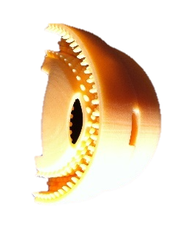
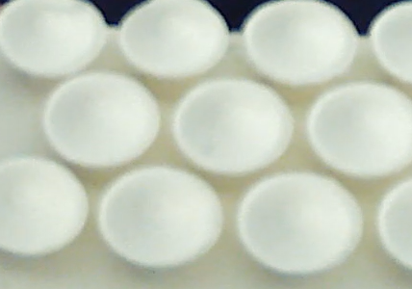
Clean Bite™ I & II
Clean Bite™ I and II represent a completely different method of brushing teeth in humans and pets!
No abrasion caused by pointed bristles
No aggregates, antimicrobials, parabens, gluten, sugar, triclosan, & SLS
No shards, which is the outcome of hard dental chews that fracture intentionally to accomplish the removal of plaque in pet care
The market has failed to provide alternatives to traditional methods … until now!
Easier dental hygiene is a simple chew-away

Slide 9
Pet Populations
Pet Oral Care Products
www.mordorintelligence.com/industry-report/pet-oral-care-products-market
There are five primary suppliers in this category:
Mars, Nestle’s Purina, Ceva, Virbac, and Hill’s
Market size: USD 2024 1.9B expected to be 2.61B by 2029
There are only 27 Edible Chew Treats, VOHC Accepted®
15 of the 27 chews are made by the listed companies above
LivFresh Dental Gel toothpaste has 40 Patents throughout the world
LivFresh was also awarded a CE Mark in the EU
LivFresh: the only OTC toothpaste recommended to prevent and treat
Gingivitis & Periodontitis
80% of Dogs and 70% of Cats will develop Periodontal Disease at three
years of age
Patents in this product category are not readily observed but, if applicable,
should be identified on their packaging
Combined IP brought together formulations, design, and engineering.
Dogs Cats
U. S. A. 90M 74.1M
Brazil 55M 168M
Canada 7.9M 85M
Europe 106.4M 129.1M
Totals: 259.3M 456.2M

Slide 10
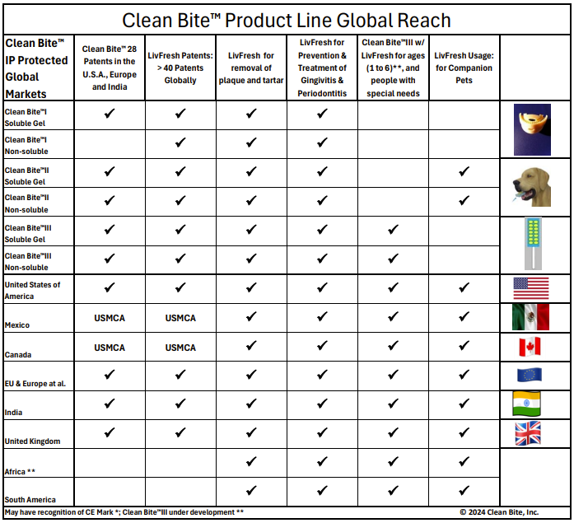
Combined Global Markets
This chart shows Global Patents for Clean Bite™ and LivFresh Dental Gel toothpaste. The products reflected use by people or companion pets, areas of defensible IP protection, and differences in solubility (editable) and non-solubility, providing advantages for specific use.
Africa, a promising region, is the subject of ongoing R&D exploring applications for NTDs.
SA, particularly Brazil, which has the second-largest global pet population, is suitable for licensing, while a strategy for the PACRIM will be determined by Livionex, Inc.

Slide 11
Ben Franklin’s Score Board
Clean Bite’s Conundrum: Focus on People or Pets?
People
Greatest Impact on Humanity
Diversified Markets
Opportunity for Collaboration
Possible Licensing
Possible M&A
Possible Exit
Use of LivFresh Dental Gel
Available Niche Markets
Greatest use of API Delivery
Support of Mission Statement
Use of both U. S. Patents
Advancing Other Causes (NTDs*)
Pets
1) Greatest Impact on Humanity
Diversified Markets
Opportunity for Collaboration
Possible Licensing
Possible M&A
Possible Exit
Use of LivFresh Dental Gel
Available Niche Markets
Greatest use of API Delivery
Support of Mission Statement
Use of both U. S. Patents
Advancing Other Causes
✓
✓
X
X
X
✓
✓
✓
✓
✓
✓
✓
9
X
X
✓
✓
✓
✓
✓
X
X
X
X
X
5
TOTALS

Slide 12
Clean Bite, Inc. wants to leverage its Global IP
Through Exclusive Licensing, M&A, VC, or Purchase According to Market Application
It is unlikely that companies that have products promoted to address plaque and tartar reduction would take on a market disruptor. The manufacturers are few and well-known to any in the industry, and much of the distribution is done online and auto-delivery.
Companies with periphery involvements may look for other inherent capabilities, e.g.:
Pharmaceutical firms advancing the use of APIs
(supplier for API applications, negotiable)
Manufacturers located in any of the IP-protected countries
Companies involved in animal health looking for expansion
Companies located in the PRC, and SA (particularly Brazil)
Mexico and Canada (USMCA member states)

Slide 13
Statement of Independent IP Ownership
Livionex, Inc. of Los Gatos, CA, has a long patent life that apply to a wide range of pathological conditions including inflammation, calcium signaling, ferroptosis, apoptosis, necrosis, metalo-lipid aggregates as well as biofilm-related pathologies (e.g., dental plaque). IP covers a class of molecules that address the role of iron and calcium in ophthalmology, dermatology, oral care, and more. Major filing jurisdictions include the US, EU, Canada, Japan, Korea, Australia, India, China, Israel, Russia, New Zealand, and the Middle East.
Clean Bite, Inc. of Haverford, PA, has two patents in the U.S., 21 in the EU, four in Europe (UK, Norway, Switzerland, and Liechtenstein), and one in India. Clean Bite™ is a U.S. Trademark registered with the USPTO. CBI focuses on product structure and formulations incorporating delivery of APIs for the Clean Bite™ I & II product lines (et al.), using single-use oral hygiene devices made of soluble foodstuff (and non-soluble formulations comparable in function) for people and companion pets in ways outside traditional methods.

Slide 14
SUMMARY
Clean Bite, Inc.
John H. Gallagher, Jr.
President and CEO
jgallagher@CleanBiteTM.com
Phone | +1-610.520.9941
Clean Bite, LLC
Haverford, PA 19041
U. S. A.
www.CleanBiteTM.com
Clean Bite™

